Slide 1
The Sweet Smoke of Rhetoric
ENGL 366C
Spring 2020
Dr. Jenstad

Slide 2
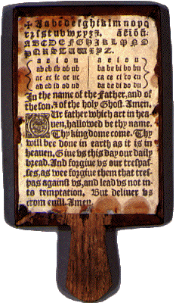
Education
Age 5-7: Dame school or petty
school (boys and girls). Hornbook was
the text.
Age 7 to 12-14: Grammar school
(boys only)
Age 12-14 to late teens-early 20s:
University or 7-year apprenticeship
Hornbook

Slide 3
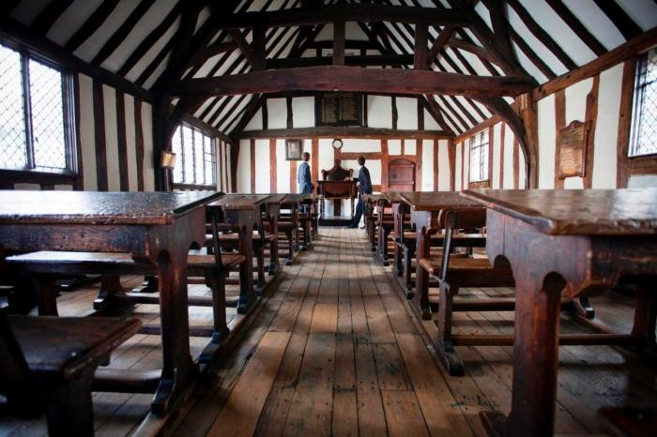
Grammar School
Notes:
Schoolroom in Stratford-upon-Avon. https://www.shakespearesschoolroom.org/

Slide 4
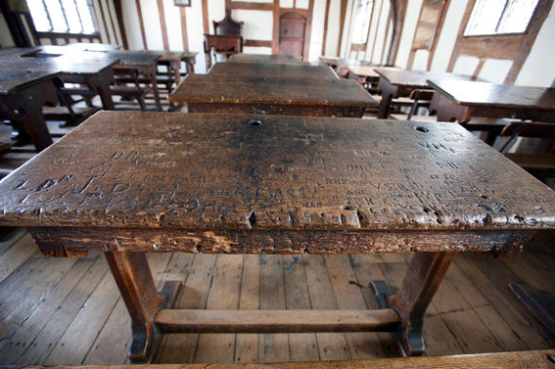

Slide 5
Grammar School Curriculum
Not a STEM curriculum! It's a HUMANIST curriculum.
The Canons of Rhetoric
Invention / inventio [creativity, originality]
Arrangement / dispositio [organization of ideas]
Style / elocutio [how you say things] → Relevant to LLL
Memory / memoria [remember and quote]
Delivery / pronunciatio [how well you recite/speak]

Slide 6
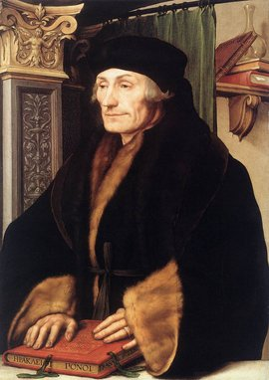
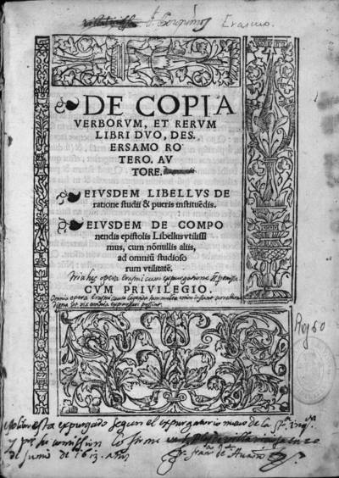
Copia
Erasmus, De Ultraque Verborum ac Rerum Copia (Copia: Foundations of the Abundant Style)
Ideal style of language: copious (abundant)
Famous for listing 195 different ways to say that
liked someone's letter

Slide 7
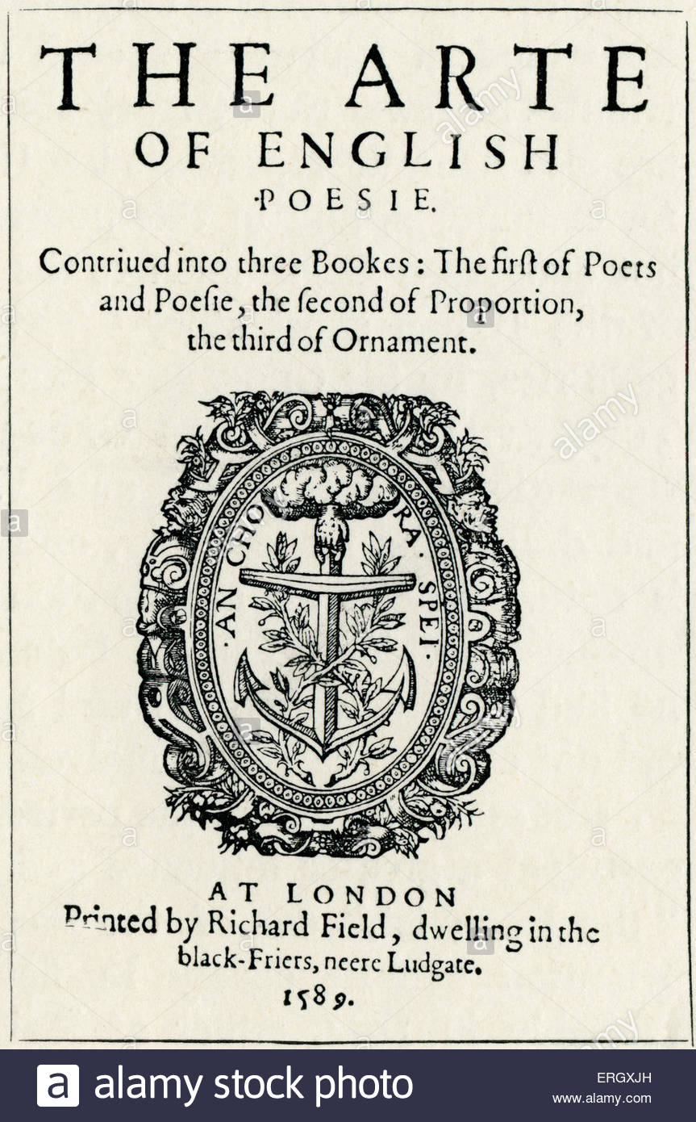
George Puttenham
The Arte of English Poesie (1589)
Book codified and gave English names
to hundreds of rhetorical devices.
Note that it is published shortly before
LLL is written and performed.

Slide 8
Figures of Sound
[I've added pronunciations. The stressed syllable is underlined.]

Slide 9
Alliteration
Definition: repeating sounds (consonance and assonance)
Note: Look for repetition of sound on stressed syllables
Some merry mocking lord belike. (Princess, 1.1)
[There are two examples of consonance in this line: on m and on l.]

Slide 10
Ploce [ploh-key]
Definition: the insistent repetition of a word within the same line or phrase
O sir, plantain, a plain plantain. No l'envoi, no l'envoi, no salve, sir, but a plantain. (Costard, 3.1.72)
[There's also paronomasia on plain/plaintain and ploce on l'envoi.]

Slide 11
Epizeuxis [eh-pee-zook-sis]
Definition: “an intensified form of ploce, repeating the word without another intervening word” (Bevington)
Puttenham calls it the “cuckoo spell.”
Cuckold, cuckold, cuckold! (Ford, MWW 2.2)
Never, never, never, never, never (Lear)

Slide 12
Parison [pear-i-zon]
Definition: “symmetrical repetition of words in grammatically parallel phrases” (Bevington)
Puttenham calls it “the figure of even."
He hath not eat paper, as it were; he hath not drunk ink. (Nathaniel, 4.2.25)
["eat paper" and "drunk ink" are grammatically parallel. Note that "eat" is the past participle of "to eat" in early modern English; it's pronounced "et."]

Slide 13
Isocolon [eye-zo-co-lon]
Definition: symmetrical repetition of sounds and words in phrases of equal length” (Bevington)
Note: isocolon is usually an instance of parison as well. If they are of equal length, they are almost always grammatically parallel as well.
study where I well may dine […] study where to meet some mistress fine (Berowne,
Or for love’s sake, a word that loves all men,
Or for men’s sake, the authors of these women,
Or women’s sake, by whom we men are men.
(4.3.332-34)
Extreme example ☺
B: Did not I dance with you in Brabant once?
R: Did not I dance with you in Brabant once?

Slide 14
Figures of sense and sound

Slide 15
Anaphora [ah-na-for-a]
Definition: “symmetrical repetition of a word at the beginning of a sequence of clauses” (Bevington).
Note: Often used in lists and catalogues.
Sweet lords, sweet lovers. (4.3.210)

Slide 16
Hyperbaton [hy-per-bait-on]
Definition: Words in a sentence or clause out of the usual order (O-V-S, for instance).
Notes: Suggests a kind of “learnedness.”
Green indeed is the color of lovers. (1.2.83, instead of the normal S-V-O order of “The color of lovers is green”)
Right you are. [Common phrase]
Anything by Yoda: Teach you I will.

Slide 17
Antimetabole [an-tee-me-tah-bow-lee], hyperbaton [hi-per-bait-on], chiasmus [kai-az-mus], antistrophe [an-tis-tro-fee]
Definition: “symmetrical repetition of words in inverted order” (Bevington).
Note: A common device in “games of wit” (tossing back the words in a new order, often to contradict or challenge the first speaker).
B: How low soever the matter, I hope in God for high words.
L: A high hope for a low heaven. (1.1.190-92)
Mote: All hail, the richest beauties on the earth!
Boyet: Beauties no richer than rich taffeta. (5.2.158-59)
[richest/richer is an example of adnominatio]

Slide 18
Antimetabole, cont.
Or for love’s sake, a word that loves all men,
Or for men’s sake, the authors of these women,
Or women’s sake, by whom we men are men.

Slide 19
Apostrophe
Definition: address to an absent person or thing
Adieu valor, rust rapier, be still drum, for your manager is in love; yea, he loveth. Assist me, some extemporal god of rhyme, for I am sure I shall turn sonnet. (Armado, 1.2.173)
[He apostrophizes valor (an abstract concept), his rapier and drum (inanimate objects), and a deity.]

Slide 20
Adnominatio [ad-nom-in-at-ee-oh]
Definition: use of a root word in two different grammatical forms
He weeds the corn, and still lets grow the weeding. (1.1.96)
To hear, or forbear hearing? (Berowne, 1.1.192)

Slide 21
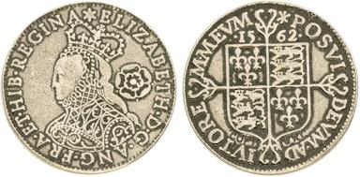
Paronomasia [pa-ron-oh-mass-ee-a]
Definition: use of a similar-sounding word with a different meaning
Note: It's a type of pun, but the term pun was not coined until the late 17thC.
Armado: I love not to be crossed.
Moth: He speaks the mere contrary: crosses love not him. (1.2.32)
  [English coins had crosses on the reverse, so they were
  synecdochically called "crosses."]
Indeed, I am in the waist two yards about. But I am now about to waste. (Falstaff in MWW, 1.3.39-40)

Slide 22
Antanaclesis [an-ta-na-klee-sis]
Definition: “the shifting of a repeated word from one meaning to another” (Bevington)
Light seeking light doth light of light beguile (Berowne, 1.1.77)
[= eyes seeking understanding might go blind with reading]
Put out the light, and then put out the light. (Othello, as he enters Desdemona's bedchamber with the intention of killing her.)

Slide 23
Anadiplosis [a-na-die-ploh-sis]
Anadiplosis – “repetition of the last part of one sentence of verse line at the beginning [or near the beginning] of the next” (Wales 276)
King: Not for the world, fair madam, by my will.
Princess: Why, will shall break it; will, and nothing else. (2.1.99-100)

Slide 24
Paradox
Definition: “an apparently self-contradictory statement” (Wales 293)
No face is fair that is not full of black. (Berowne, 4.3.251)

Slide 25
Figures of Character
These figures often tell you a lot about the person who is using them.

Slide 26
Copia
a child of our grandmother Eve, a female, or, for thy more sweet understanding, a woman (Armado, in the letter read aloud in 1.1)

Slide 27
Synonymia [sin-on-im-ee-a]
Definition: strings of synonyms (in apposition)
The deer was, as you know, sanguis, in blood, ripe as the pomewater, who now hangeth like a jewel in the ear of caelo, the sky, the welkin, the heaven, and anon falleth like a crab on the face of terra, the soil, the land, the earth” (Holofernes, 4.2.3-7)
undressed, unpolished, uneducated, unpruned, untrained, or rather unlettered, or ratherest unconfirmed fashion (Holofernes, 4.2.16)
[For Holofernes, copia is simply synonymia; he is a walking thesaurus!]

Slide 28
Parenthesis
Definition: apparent self-interruption
I doe affect the very ground (which is base) where her shooe (which is baser) guided by her foote (which is basest) doth tread. I shall be forsworn (which ia a great argument of falshood) if I loue. (Armado, TLN 470)
[I've quoted from the 1623 folio to preserve the punctuation.]

Slide 29
Gradatio [grah-dah-tee-oh]
Definition: “presents arguments in an ascending order” (Wales)
“the ladder” (Puttenham)
He came, one; see, two; overcame, three. (Armado, 4.1.70)

Slide 30
Quaesitio [kwy-e-sit-ee-o]
Definition: a string of questions, one after the other
What plume of feathers is he that indited this letter?
What vane? What weathercock?
Did you ever hear better? (Rosaline, 4.1.93)

Slide 31
Rhetorical Question
Definition: a question whose answer is self-evident or made evident in the asking
And how can that be true loue, which is falsely attempted? (Armado, 1.2 QLN 473)
[If it's not done sincerely, it's not true love.]
What, what? First praise me and again say no?
A short-lived pride! Not fair? Alack, for woe! (Princess, 4.1.14-15)

Slide 32
Stichomythia [stick-oh-myth-ee-a]
Definition: dialogue in alternate lines, usually deploying many other rhetorical devices.
Note: Often meant to be read as a game of wit.
B: Lady, I will commend you to mine own heart.
R: Pray you, do my commendations; I would be glad to see it.
B: I would you heard it groan.
R: Is the fool sick?
B: Sick at the heart.
R: Alack, let it blood.
B: Would that do it good?
R: My physic says ay.
B: Will you prick't with your eye?
R: Non point, with my life.
B: Now God save thy life.
R: And yours from long living.
B: I cannot stay thanksgiving. (2.1.180ff)

Slide 33
honorificabilitudinitatibus
ho-no-ri-fi-ca-bi-li-tu-di-ni-ta-ti-bus
[the state of being honoured]
Costard wonders why Armado, Holofernes, and Nathaniel haven't eaten the word "mote."

Slide 34
Useful Links
Silva Rhetoricae: The Forest of Rhetoric. Compiled by Dr. Gideon Burton. http://rhetoric.byu.edu/

