Slide 1
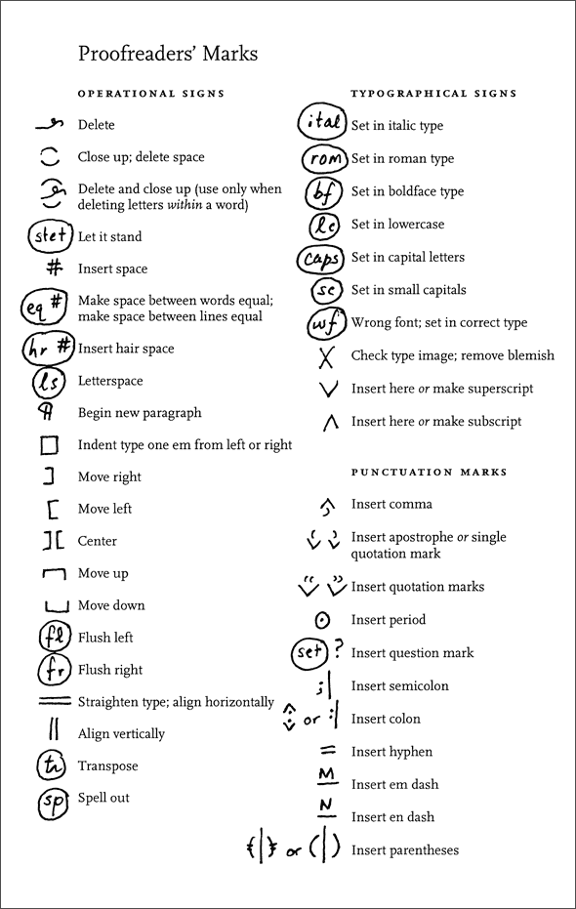

Slide 2
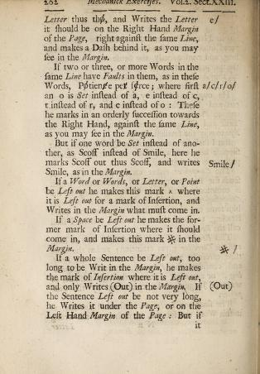
  Joseph Moxon, Mechanick Exercises,
  or, The Doctrine Of Handyworks: Applied to the Art
  Of Printing. London, 1683.

Slide 3
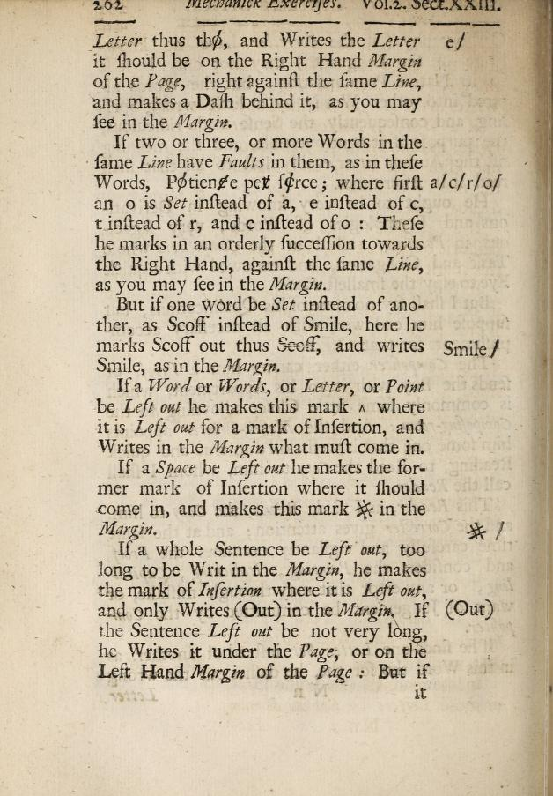
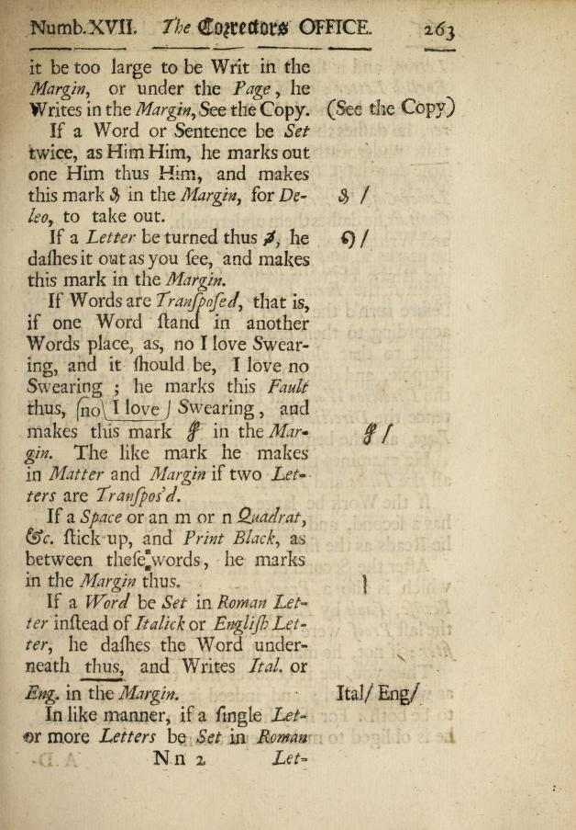
Notes:
Joseph Moxon, Mechanick Exercises, 1683

Slide 4
Preliminary definition of markup
Marks added to the text that are not PART of the text.
Marks that instruct someone to do something with the text.
Marks that are meant to be read by somebody other than the eventual reader of the text.

Slide 5
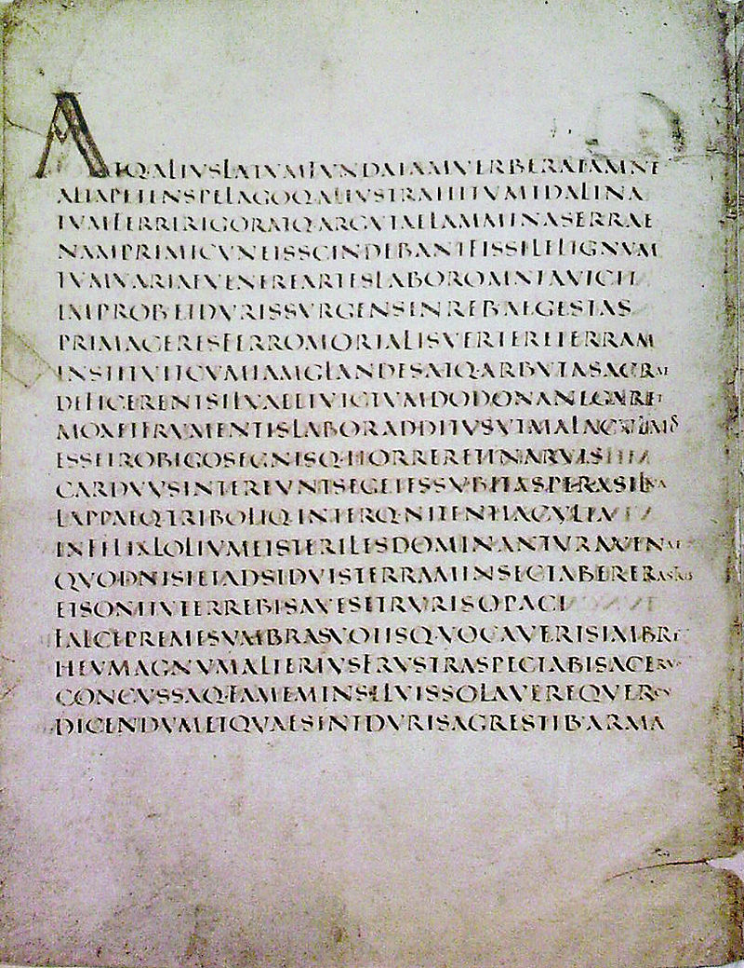
Notes:
Scriptio continua. Chinese scripts and other eastern scripts lacked spaces until the 20th cent.

Slide 6
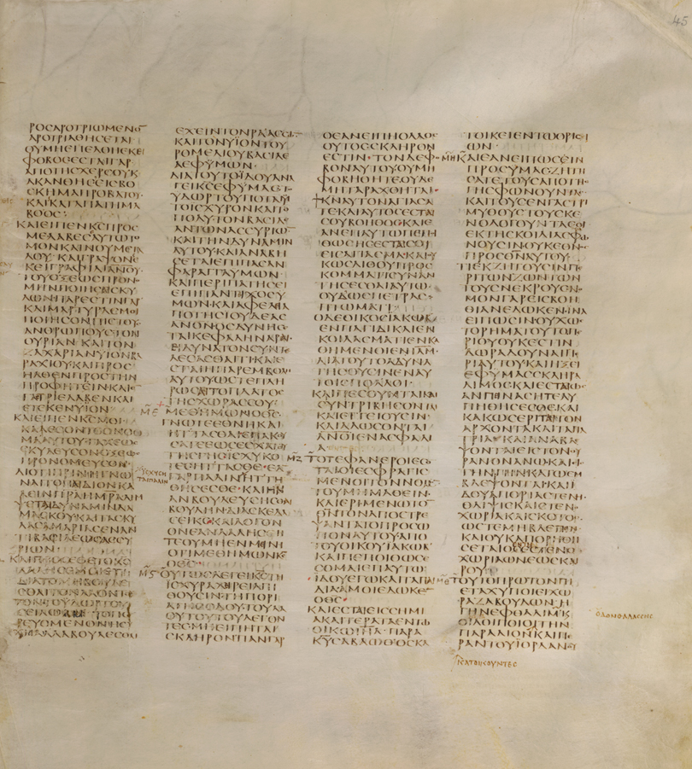
Notes:
Medieval manuscript in Greek

Slide 7
Eats, shoots and leaves: Punctuation as markup
Let’s eat, Bob! Let’s eat Bob!
Three year-old children Three-year-old children

Slide 8
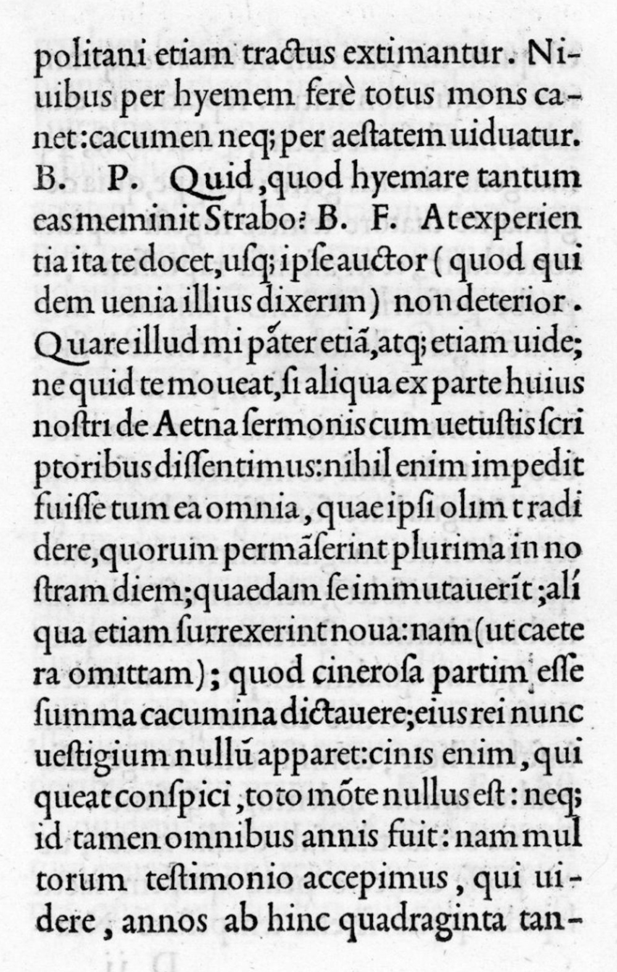
Notes:
Aldus Manutius – inventor of the semi-colon (in 1494). Text is De Aetna by Pietro Bembo.

Slide 9
Punctuation as voice markup
Period = long pause
Comma = short pause
Parentheses = a lower and quicker tone
Semi-colon = a pause longer than a comma but shorter than a period

Slide 10
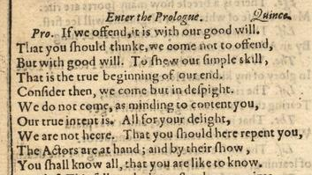

Slide 11
Theseus: This fellow doth not stand upon points.
Lysander: He hath rid his prologue like a rough colt;
He knows not the stop. A good moral, my lord.
It is not enough to speak, but to speak true.
(Shakespeare, A Midsummer Night’s Dream, 5.1)

Slide 12
If we offend, it is with our good will
That you should think we come not to offend.
But with good will to show our simple skill--
That is the true beginning of our end.
Consider then we come. But in despite
We do not come. As, minding to content you,
Our true intent is all for your delight.
We are not here that you should here repent you.
The actors are at hand, and by their show,
You shall know all that you are like to know.

Slide 13
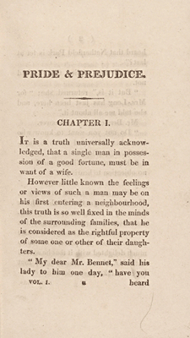

Slide 14
How do you know what the title is?
How do you know where paragraphs begin and end?
How do you know when someone is speaking?
How do you know when sentences/clauses begin and end?
How do you know when words begin and end?

Slide 15
Capital letters (all caps)
Centering
Indentation
Quotation marks
White space

Slide 17
Burnard, Lou, Katherine O’Brien O’Keeffe, and John Unsworth, eds. Electronic Textual Editing. New York: MLA, 2006.
Notes:
A page from Virgil’s Georgics

Slide 18
When does MARKUP Become part of the text?
Diacritical marks
Example of Hebrew. Markup (including vowels, which are thought of as markup) must not be added to the most sacred texts. Vowels added to modern Hebrew texts.
Indigenous languages. Usually transliterated with a lot of what looks like markup to English-speakers.
Apostrophes
Example of: it’s // its. The apostrophe + s [marking the genitive or possessive case]

Slide 19
Other kinds of markup
  Italics for emphasis
  Underlining for titles
  Bold for extra-emphasis
  Quotation marks for “outside attribution” or “skepticism”
  All capitals to YELL

