Slide 1
Documentation
What is it and who needs it?
Janelle Jenstad
Notes:
1

Slide 2
What is Documentation?
Documentation is a “memory container.”
The meta-metadata of your project

Slide 3
Documentation in DH
Documentation is common in the IT world.
Not so common in the DH world.

Slide 4
Why do we document?
Because we forget what we did or decided.
Because others need to know what we did or decided.
Because people who use our tools, schema, customization need to know how to use it.

Slide 5
Key Questions
Who needs documentation?
What information do they need?
Taxonomy of documentation
Questions of style

Slide 6
Who needs documentation?
MAKING: Contributors to the project
USING: Users of the project
STORING: Archivists and remediators of the project (the memory keepers)

Slide 7
The Makers: Contributors to the Project
  New RAs
  Continuing RAs
  External Contributors
  Pedagogical Partners (Guest Editors and Students)
  Programmers and Junior Programmers
  The PI (who regularly forgets)

Slide 8
The Users (of MoEML)
Scholars
Teachers
Students
Other DH projects (they like our data)
Genealogists
Novelists (and their Twitter followers)
And … physicists?

Slide 9
“The most interesting use of our data will not be what we think it is.” -- Mike Poston, Programmer, Folger Shakespeare Library
https://collation.folger.edu/2011/12/the-most-interesting-use-of-our-data-will-not-be-what-we-think-it-is/

Slide 10
The Memory Keepers
Archivists
Librarians
Users we can’t even imagine
Someone who decides to remediate the project

Slide 11
What information do the Makers need to know?
The Makers:
Need to know how to do things
Need to know what to include and what not to include

Slide 12
Praxis
https://jenkins.hcmc.uvic.ca/job/MoEML/lastSuccessfulBuild/artifact/static/site/praxis.htm

Slide 13
Contributor information
https://jenkins.hcmc.uvic.ca/job/MoEML/lastSuccessfulBuild/artifact/static/site/contribute.htm

Slide 14
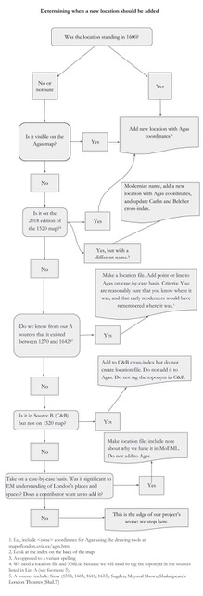

Slide 15
What information do the users need to know?
Where you got your texts/data (the infamous <sourceDesc>)
What you did to the text/data
Your principles of inclusion/exclusion (scope)
Who did what when (for citation purposes)
How to find things
How to use the features of the site
How to contact you, submit corrections, et cetera
Permissions and rights
Licensing for re-use

Slide 16
Textual Essay – standard scholarly stuff
Editorial Note
Remediation History
Encoding Description
Hint! You can repurpose a lot of your “how to” documentation.
E.g., https://jenkins.hcmc.uvic.ca/job/MoEML/lastSuccessfulBuild/artifact/static/site/diplomatic_transcriptions.htm

Slide 17
What information do the memory keepers need?
Metadata (in a format that they can add to their catalogue)
File types
Permissions and rights
A project history?
Information on any lingering dependencies
Information on technologies required to build it. Code structure.

Slide 18
Types of Documentation
How-to documents for the encoder and RA
What we did (to the text): Editorial Decisions and Encoding Decisions
End-user documentation: how to use project
How the code works
Requirements: to build, reboot, or rebuild the system
Technical and Procedural Documentation

Slide 19
How do we write it? Questions of Style
“How to” – use second-person, verbs, imperatives.
“Descriptive” – first person (singular or plural, as required)

Slide 20
Where do we keep documentation?
On the site
  In the metadata of every file
  On the bottom of every page
  In a section with a descriptive name (which you have to curate)

Slide 21
Pro-Tip
Create a “document type” for documentation
https://jenkins.hcmc.uvic.ca/job/MoEML/lastSuccessfulBuild/artifact/static/site/mdtDocumentation.htm

Slide 22
When and how do you update it?
Regularly!
Make a decision
Photograph the whiteboard
Add a task to “Add that decision to documentation” (attach the whiteboard photo)
Write the new documentation as soon as you’ve tested the implications of the decision

Slide 23
Do the same at the local level.
E.g., Write xml comments in your files
<!-- Decided this was a long S -->

Slide 24
Project Continuity
Where are other team members preparing and storing their work?
What email account are they using for project correspondence?
Where are they documenting their work?

Slide 25
Consider …
Versioning your working documents (in the repository)

Slide 26
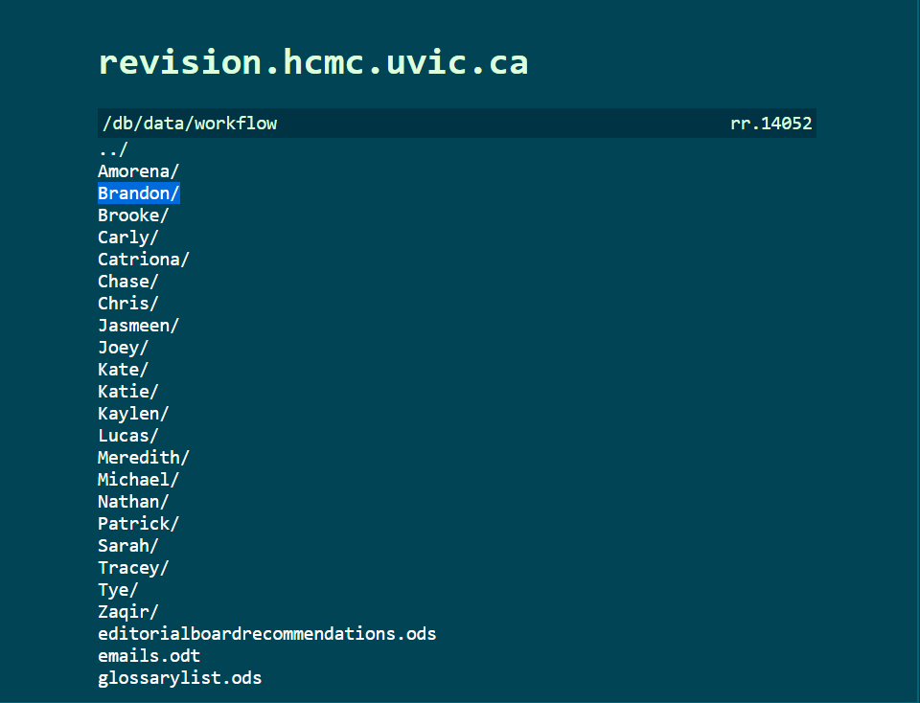
Consider …
Versioning your working documents (in the repository)
Setting up shared workspaces
JT </e> MH

Slide 27
Consider …
Setting up shared workspaces
GoogleDrive – make sure the project is the owner (via the project email)

Slide 28
Consider …
Project email accounts:
  london@uvic.ca
  digitalrenaissanceeditions@gmail.com
Role-based email accounts:
  moemlras@uvic.ca
  moemljuniorprogrammer@uvic.ca
  londonpm@uvic.ca
  lemdotech@uvic.ca

Slide 29
What else do you need to document?
Records Management System
Where are the files (electronic and analogue)?
Not all records belong on your site (some aspects of project history, personnel records, most parts of grant applications)
What to do if a key team member is hit by that bus we keep talking about?
(But don’t stop taking the bus. It’s good for the environment ☺)
Notes:
29

Slide 30
Your “hit-by-a-bus” document
Where to find your “Records Management” document
Who has keys to the filing cabinet
Who has access to various digital storage and workspaces
To whom access should be given
Grant numbers, signing authorities, delegates
Successor (if you need one on a grant)
(Your programmer will have a “hit-by-a-bus” document too.)

Slide 31
Debunking Myths
Code is not self-documenting.
ODD files are not self-documenting either.

Slide 32
Resources
Claire Warwick et al. “Documentation and the Users of Digital Resources in the Humanities.” Journal of Documentation 65.1 (2009): 33-57. https://doi.org/10.1108/00220410910926112.

