Slide 1

B.C. Hansard Services and XML
Dan Kerr — Manager of Publishing Systems
Barb Horricks — Galley Team Leader
Kim Christie — Editorial Team Leader
Notes:
What brought you to a class on XML?

Slide 2
B.C. Hansard Services and XML
What is Hansard?
Hansard Editing and Professional Writing
XML in Our Work
Our Publishing Workflow
XML Training
Questions

Slide 3
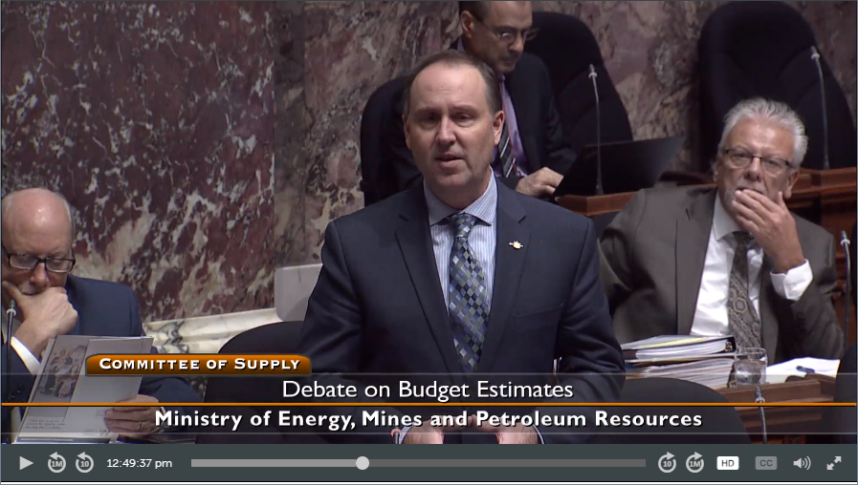
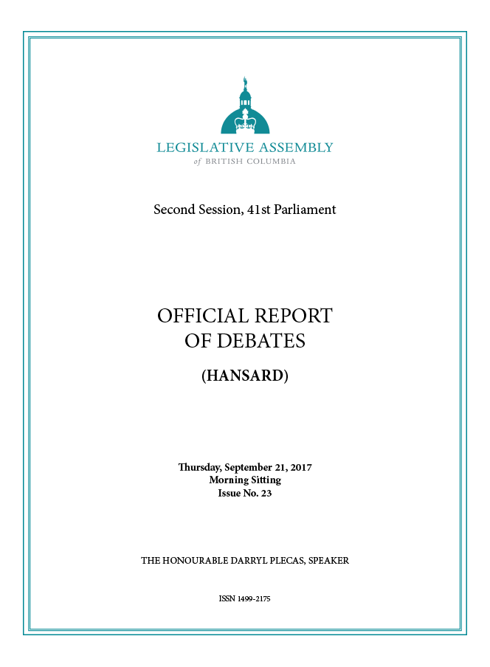

What is Hansard?
Official Report of Debates
Substantially verbatim transcription of chamber debates and parliamentary committee proceedings
Indexes of transcripts
Broadcasts, live streams and archive video
Notes:
The name for the transcript of parliamentary debates throughout the Commonwealth
Timelines
One hour later for draft Blues
About three days for the final
Products
Blues
Finals
Indexes
Broadcasts
Webstreams
Archive videos
Majority of users are online both readers and viewers
Who uses it?
The members and their staff
The press
What was going on today?
What was going on in the ‘90s?
Government
Tracking legislation
Budgets
Drafting new legislation
The legal community
Legislative intent
Social Science Researchers
Prayers and Reflections
Indigenous Researchers
Citizens, lobby, and civil society groups
Historians

Slide 4
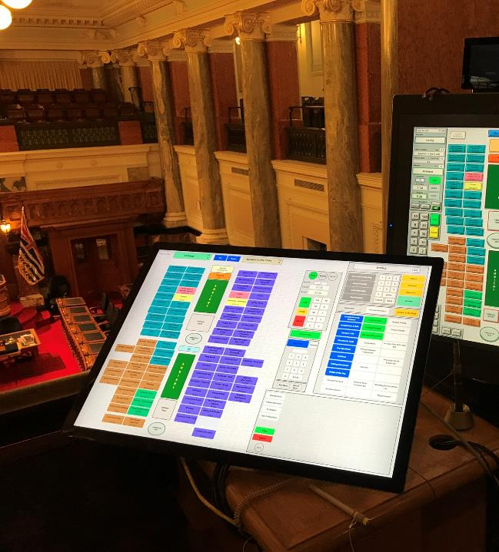
Recording the debates
The console operator’s tablet
Notes:
Here you can see the console operator’s position and the chamber in the background
The speaker or chair recognizes a member
The console operator activates their microphone
A camera moves to a preprogramed position

Slide 5
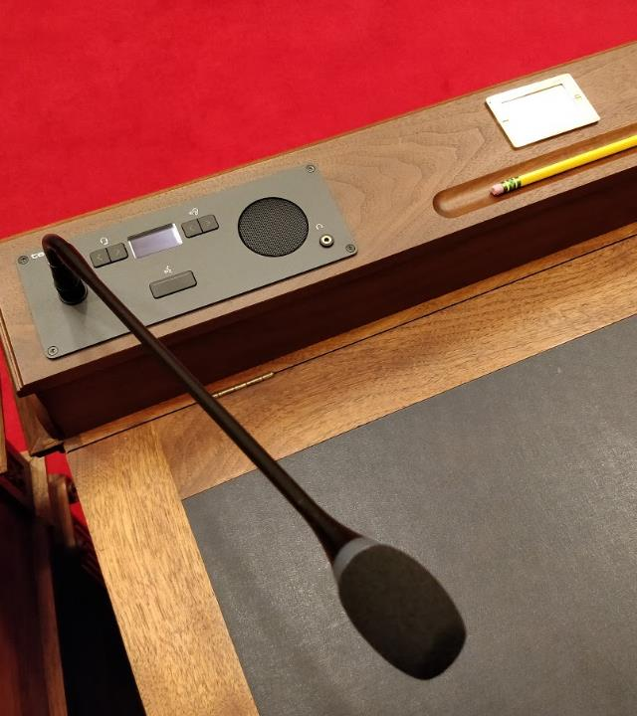
Recording the debates
A member’s desk and microphone
Notes:
Magnetic tape
Member is recognized by the Speaker or Chair
Microphone is activated
Camera orients automatically on the member
Eby vs. Selina Robinson
Captioning
Recorded in five-minute segments
Proceedings in the Chamber, Douglas Fir and Birch Committee Rooms
PART IV - RECORDING OF DEBATES
Recording of debates.
120. The debates of the Legislative Assembly in the House and all Committees of the House shall be recorded by means of magnetic-tape recorders or other suitable recording devices in accordance with the following rules:
Magnetic-tape record under control of the Speaker.
(1) The magnetic-tape record of the said debates shall be under the control and custody of the Speaker and no duplicate or copy of the magnetic-tape record shall be made without the express authority of the Speaker.
(2) The public use, employment, publication, transmission, or broadcast outside of the House of the magnetic-tape record of the said debates, or any portion thereof, is prohibited without the express authority of the Speaker.
(3) Any person who, without the express authority of the Speaker, offends against sections 1 and 2 of this Order may be considered in contempt of the House.
(4) When any question arises in the House as to the words spoken by a Member in its said debates of the House and all Committees of the House, the Speaker may use the magnetic-tape record as evidence of the actual words spoken by that Member.
(5) An official report, substantially verbatim, of the said debates in the House and Committee of the Whole shall be prepared under the supervision of the Speaker and a copy thereof shall be distributed:
(a) without charge to every Member, and
(b) to any other person at a charge to be fixed by Order in Council.
(6) A Member may make no alterations, additions or deletions to the report which would in any way tend to change the context of that which has been spoken.

Slide 6
B.C. Hansard Services and XML
What is Hansard?
Hansard Editing and Professional Writing
XML in Our Work
Our Publishing Workflow
XML Training
Questions

Slide 7
Hansard, Editing and Professional Writing
What is “substantially verbatim”?
  Minimal intervention
  Editing lightly for meaning/readability
  Preserving the intention of the member's speech
Common editorial challenges
Notes:
Substantially verbatim
Hansard edits its documents with the goal of “substantially verbatim” reporting, which has a focus on:
This is a full report in the first person, of all speakers alike, which, though not strictly verbatim, is substantially the verbatim report with redundancies and repetitions omitted and obvious mistakes corrected, but which on the other hand leaves out nothing which adds to the meaning of the speech or illustrates the argument.
Hansard edits its documents with the goal of "substantially verbatim" reporting, which has a focus on:
Minimal intervention
Editing lightly for meaning/readability
Preserving the intention of the member's speech (ambiguity, elliptical, etc.)
Common challenges
Repetition / false starts
Ambiguity
Ellipticals
Listening challenges
Numbers, quotes and research items
Language (ESL speaker, foreign languages, etc)
Question Period
Procedural

Slide 8
Hansard, Editing and Professional Writing
Roles supporting Editorial team — a group effort!
Our editing workflow
  First-Line Editing
  Second-Line Editing
  Document Assembly
  Galley Editing
Notes:
Editing workflow
First-Line Editing: A five-minute audio segment called a "take"; editor listens to audio (at least once) and does a readthrough; get all words down and send research queries; 45-minute deadline
Second-Line Editing: Second look at the text; 60-minute deadline; listening and reading in equal measure; implementing research queries; ensures procedure is correct and nothing is missed
Document Assembly: Stitches together second-line takes; fixes overlap text; variable deadline; creates the "revised Blues" document
Galley Editing: Finalizing the document; timelines are more variable; looks at the bigger picture and structure of the document (procedural, tagging, etc).
Roles supporting the editorial team
Production Management Team
Research
Indexing
Technical Operations
Audio

Slide 9
B.C. Hansard Services and XML
What is Hansard?
Hansard Editing and Professional Writing
XML in Our Work
Our Publishing Workflow
XML Training
Questions

Slide 10
XML in Our Work
Why do we use XML?
What do the products look like?
XML editing at Hansard and our tools
Notes:
Why are we using XML
Open tools and platforms
Long-term preservation
Single-source publishing — HTML, PDF, XML, plain text, etc.
Interoperability and reuse
Searching
XML editing at Hansard
Blues HTML publishing
Galley stage
What is a top-level overview of the galley process?
What are the tools we are using to complete the galley process?
Word
Outlook – Email!
OneNote
oXygen
Prince
Python
Java
JavaScript
Samples — PDF, HTML, XML, schema

Slide 11
The Hansard Workflow
Today’s Headings
Transcription/
First Edit
Blues
Research
Second Edit
Revised Blues
Motions and Amedments
Document Assembly
Table of Contents
Rough Galley
(oXygen — XML edit)
PDF
Publication to
Public Website
Indexing
Forced Alignment
HTML

Slide 12
B.C. Hansard Services and XML
What is Hansard?
Hansard Editing and Professional Writing
XML in Our Work
Our Publishing Workflow
XML Training
Questions

Slide 13
Our Publishing Workflow
Single source publishing
  HTML — Styled by CSS and enabled by JS
  PDF-A/3u — Secured by digital certificate
  Plain text for forced alignment with video
  List of corrections over time
Notes:
Security of the PDF meet the expectation of fixity set by the print document.

Slide 14
B.C. Hansard Services and XML
What is Hansard?
Hansard Editing and Professional Writing
XML in Our Work
Our Publishing Workflow
XML Training
Questions

Slide 15
XML Training
Galley Team
Technical Operations and Publishing Team
Notes:
XML for Galley Editors
Evolution from Word styles
On the job training in the Hansard publishing system
XML for Technical Operations and Publishing
Hiring with an eye on XML experience
Difficult to recruit for XSL
Python and CSS/JS manipulation of the document

Slide 16
Thank you!
B.C. Hansard Services
Dan Kerr • Barb Horricks
Kim Christie
Questions?

